Slide 1


Natural Language Processing Tutorials
Become a natural language processing expert
Supervised by Dr. Kenny Zhu
TAs: Essam Abdelghany

Slide 2
Pop Quiz
Reminder in tutorials we recap on lecture via pop quiz, learn technologies discuss hard problems in assignments, demonstrate practical aspects of content learnt in lecture

Slide 3

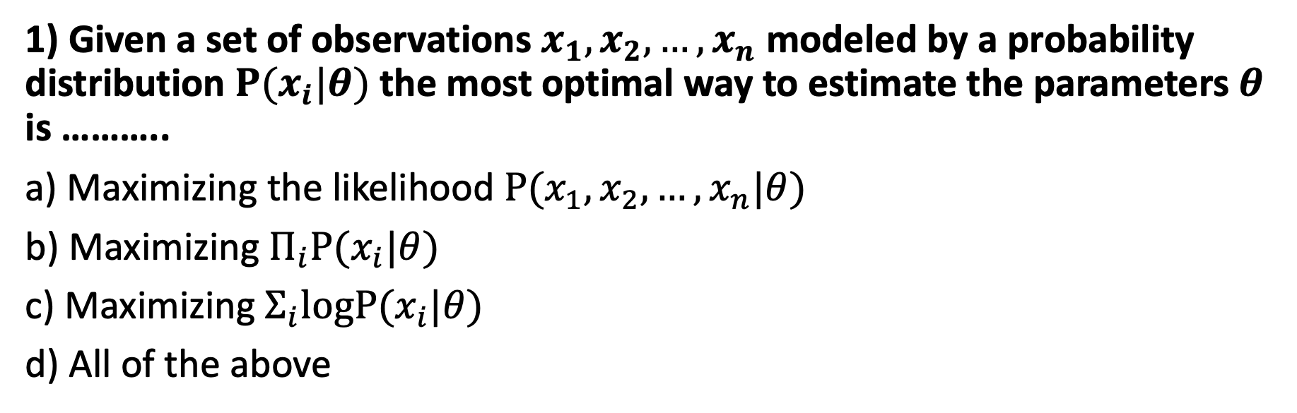
Pop Quiz
1) Given a set of observations $x_{1},x_{2},…,x_{n}$ modeled by a probability distribution $P(x_{i}|θ)$ the most optimal way to estimate the parameters $θ$ is ………..
a) Maximizing the likelihood $P(x_{1},x_{2},…,x_{n}|θ)$
b) Maximizing $Π_{i}P(x_{i}|θ)$
c) Maximizing $Σ_{i}logP(x_{i}|θ)$
d) All of the above
Take notes as quizzes may not be posted in solved form.

Slide 4
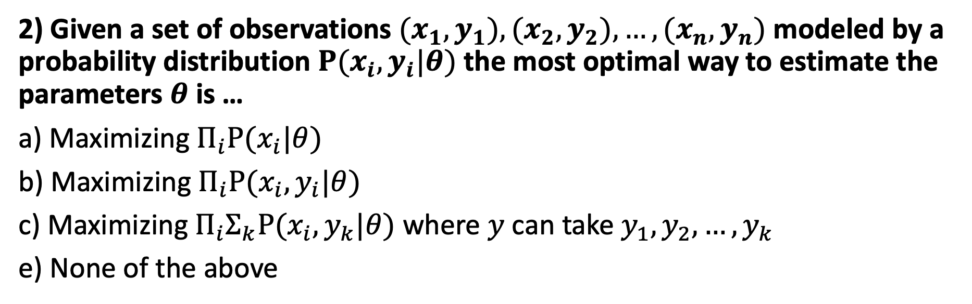
Pop Quiz
2) Given a set of observations ${(x}_{1},y_{1}),{(x}_{2},y_{2}),…,{(x}_{n},y_{n})$ modeled by a probability distribution $P(x_{i},y_{i}|θ)$ the most optimal way to estimate the parameters $θ$ is …
a) Maximizing $Π_{i}P(x_{i}|θ)$
b) Maximizing $Π_{i}P(x_{i},y_{i}|θ)$
c) Maximizing $Π_{i}Σ_{k}P(x_{i},y_{k}|θ)$ where $y$ can take $y_{1},y_{2},…,y_{k}$
e) None of the above

Slide 5
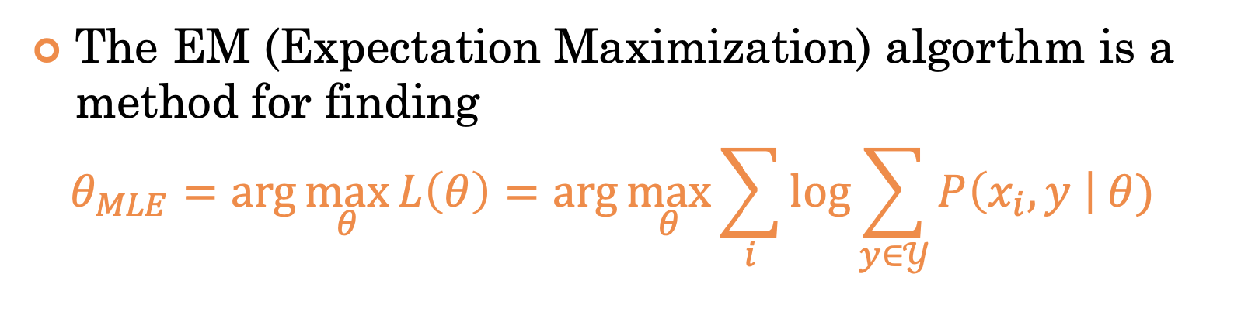
Pop Quiz

Slide 6
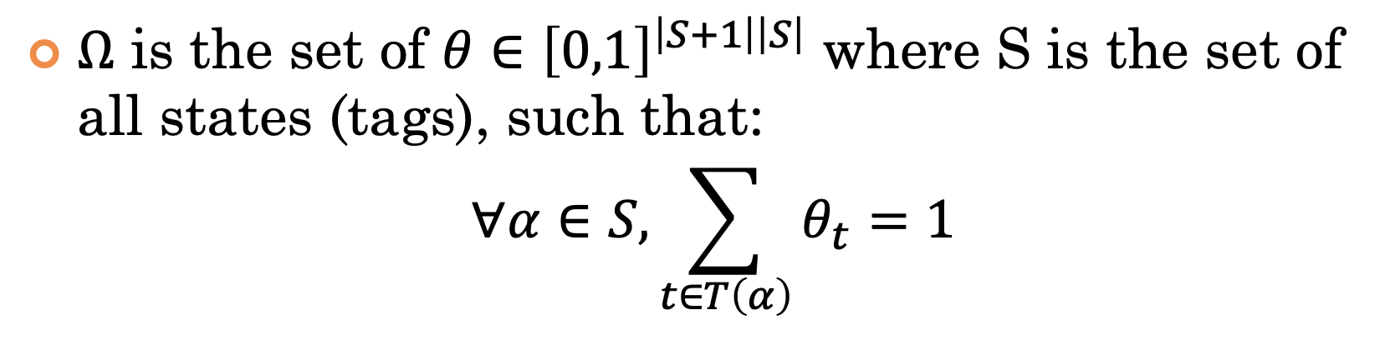
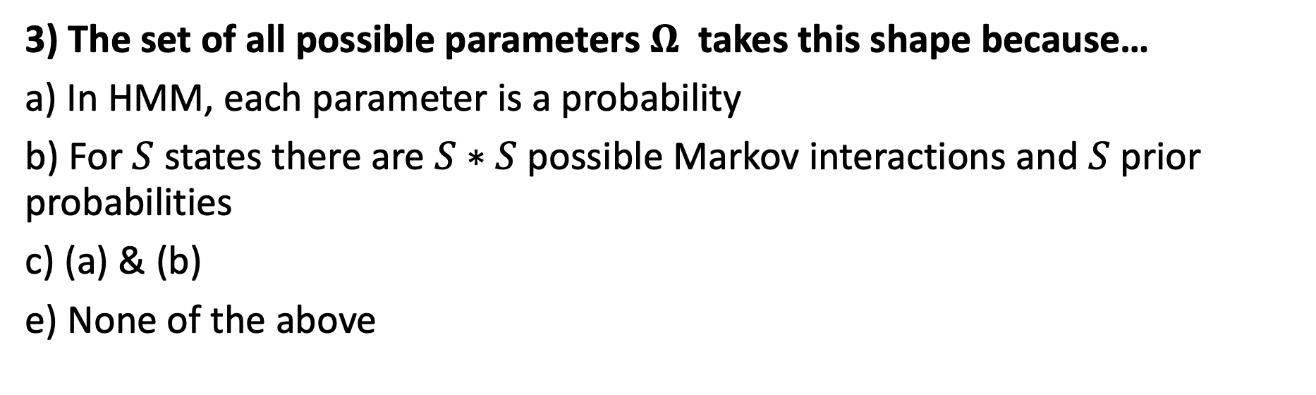
Pop Quiz
3) The set of all possible parameters $Ω$ takes this shape because…
a) In HMM, each parameter is a probability
b) For $S$ states there are $S∗S$ possible Markov interactions and $S$ prior probabilities
c) (a) & (b)
e) None of the above

Slide 7

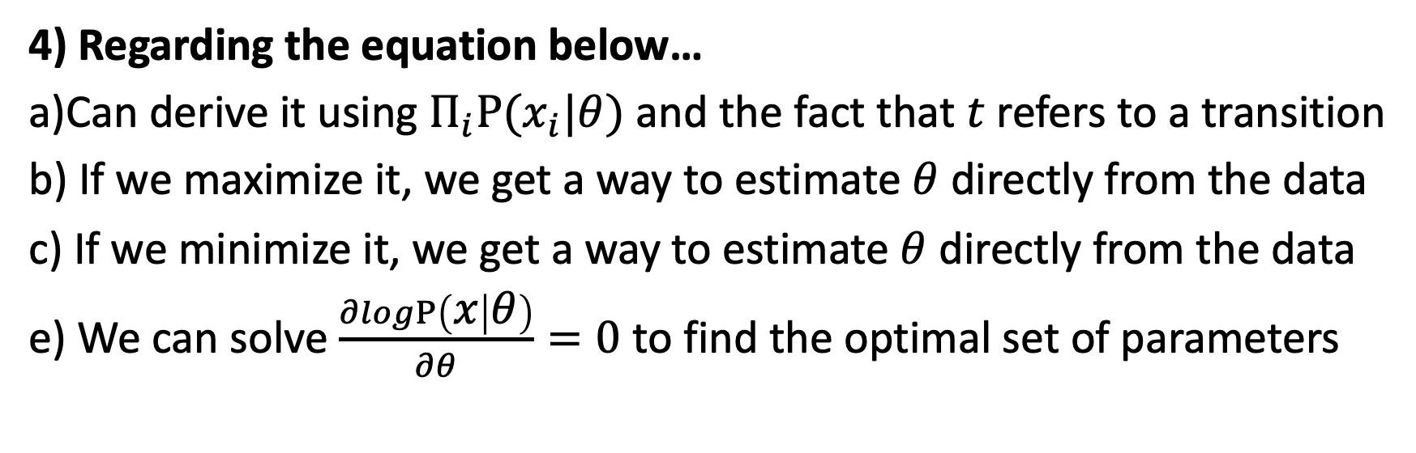
Pop Quiz
4) Regarding the equation below…
a)Can derive it using $Π_{i}P(x_{i}|θ)$ and the fact that $t$ refers to a transition
b) If we maximize it, we get a way to estimate $θ$ directly from the data
c) If we minimize it, we get a way to estimate $θ$ directly from the data
e) We can solve $\frac{∂logP\left(x | θ\right)}{∂θ}=0$ to find the optimal set of parameters

Slide 8
Pop Quiz
5) In the EM algorithm
a) It’s possible to estimate the MLE without labels (like KMeans)
b) If the fully observed data has a simple solution then so will the partially observed data
c) Initialization does not matter
e) All of the above

Slide 9
Pop Quiz
6) Fundamental Problems HMM can solve
a) Given the model parameters and observed data, estimate the optimal sequence of hidden states.
b) Given the model parameters and observed data, calculate the model likelihood.
c) Given just the observed data, estimate the model parameters.
e) All of the above

Slide 10
Thank You

